Slide 1
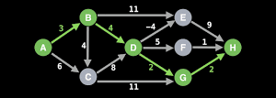
NP-Complete – Longest Path
By: Kiavash Seraj & Trevor Nicholas

Slide 2
Longest Path - Explanation
Although confusing from the problems name, the longest path problem is the problem of finding a simple path (does not have any repeated vertices) of maximum length in a given graph. The graph must be directed, and can be weighted.
Decision problem - Is there a simple path of cost >= k in this graph?
Optimization problem - find the most expensive path possible in the graph given

Slide 3
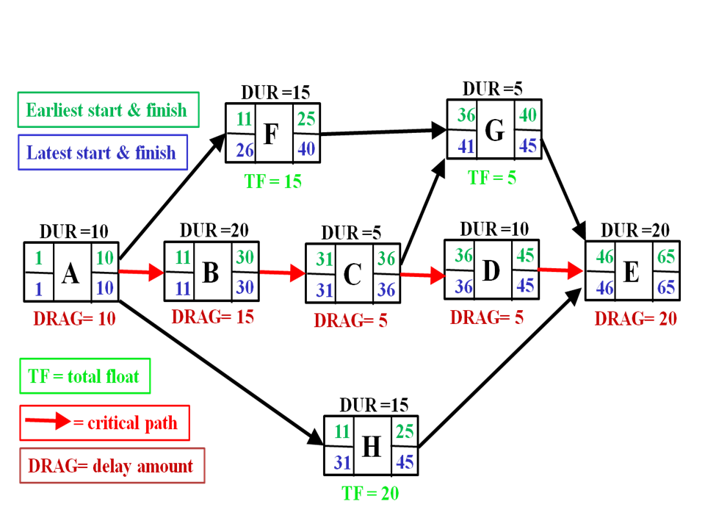
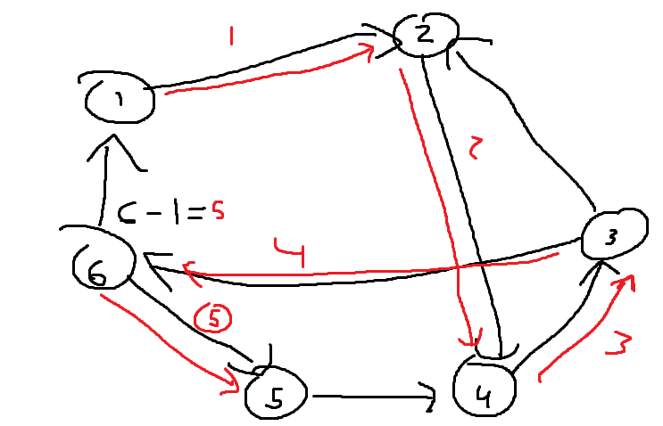
Applications
NP-Hardness
Critical path for product development
Risk modeling in financial markets
Hamiltonian Path can be solved by reducing the decision problem in an unweighted graph when k=v-1
If the longest simple path is of size v-1/there is a simple path of size v-1, then there is a hamiltonian path present
Sources - above: Wikipedia below: me

Slide 4
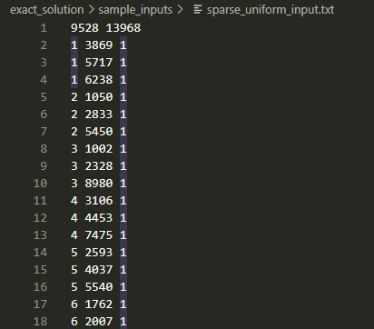
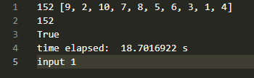
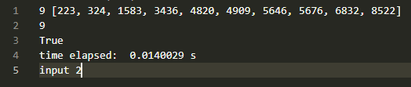
Input/output definition
1st input - fully connected graph of 10 vertices & randomized weights
2nd input - sparse graph with nearly 9528 vertices and 13968 edges

Slide 5
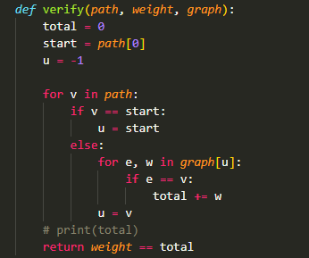
Verification tool
Worst case is fully connected graph & path of length v-1
For v in path - at most size V
For e, w in graph[u] - also at most size V
Worst case is V*V or V^2 which is polynomial time

Slide 6

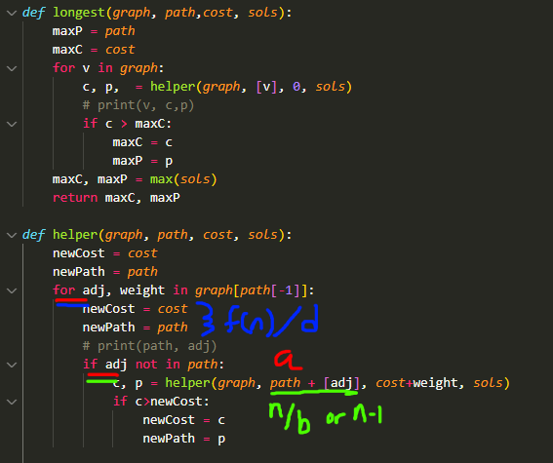
Exact code/demo
Big O analysis
I used a recursive function with a worst-case recurrence relation:
T(n) = aT(n/b) + f(n)
T(v) = (v-1)T(v-1) + v
Using Master’s theorem,
T(n) in O(n^d) if a<b^d,
A = v-1, b^d = (v-1)^v
a<b^d
Could accelerate with dynamic programming
Notes:
My recurrence might be factorial

Slide 7
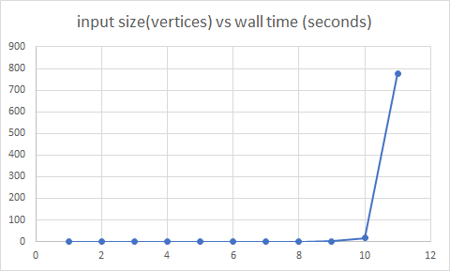
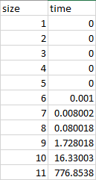
Wall Clock Analysis
All inputs were uniform cost connected graphs of increasing vertex count
Any input size > 11 caused vscode to crash on my ryzen 5 5600x & 16gb ddr4

Slide 8
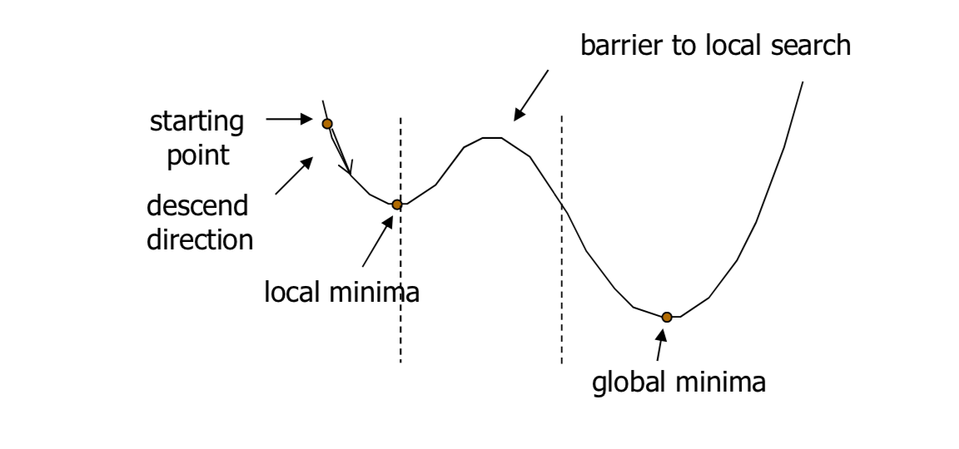
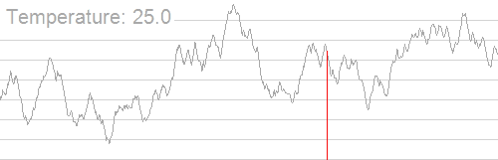
Simulated Annealing Approximation Pseudo Code
function SimulatedAnnealing(graph, initial_temperature, cooling_rate, stopping_temperature):
current_path = GenerateRandomPath(graph)
current_length = CalculatePathLength(graph, current_path)
best_path = current_path
best_length = current_length
temperature = initial_temperature
while temperature > stopping_temperature:
new_path = GenerateNeighborPath(graph, current_path)
new_length = CalculatePathLength(graph, new_path)
if new_length > current_length:
current_path = new_path
current_length = new_length
if new_length > best_length:
best_path = new_path
best_length = new_length
else:
accept_probability = exp((new_length - current_length) / temperature)
if random() < accept_probability:
current_path = new_path
current_length = new_length
temperature = temperature * cooling_rate
return best_path
function GenerateRandomPath(graph):
// Generate a random path in the graph
function GenerateNeighborPath(graph, path):
// Generate a new path starting from a random index in the path given.
function CalculatePathLength(graph, path):
// Calculate the length of the path by summing the weights of its edges

Slide 9
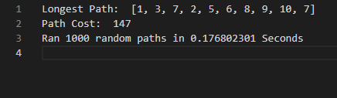
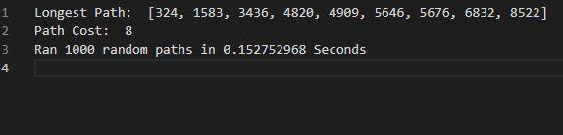
Approximation vs Exact Solution
Annealing Simulation Approximation
Exact Solution
1st input - fully connected graph of 10 vertices & randomized weights
2nd input - sparse graph with nearly 9528 vertices and 13968 edges

Slide 10
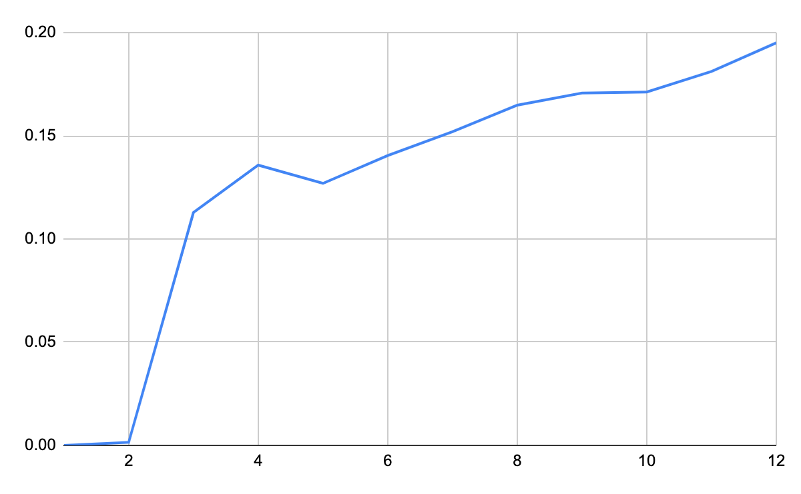
Wall Clock Analysis
Exact solution Approximation
Input size(vertices) vs wall time (seconds

Slide 11
Simulated Annealing Algorithm Analysis
O(darts X O(GenerateRandomPath()) X logcoolrate(endtemp/starttemp)
Big-O simplified = V * constants
Darts = iterations of paths to be passed to the simulated annealing algorithm
GenerateRandomPath = function for generating random path (V time at worst case)
logcoolrate(endtemp/starttemp)= Expression representing the most times annealing is tried on each starting ‘dart’ - if cool rate = .95, start = 1000, end = 100, logcoolrate(endtemp/starttemp)= 45

